Slide 1
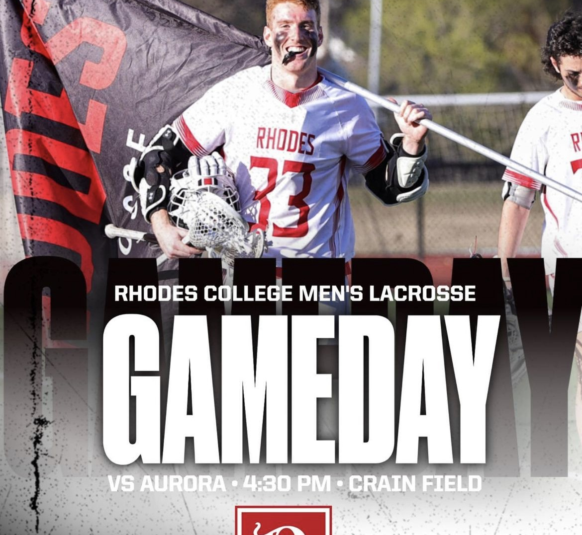
Virtual Reality Lacrosse Training
Martin Maxim
Project 3 325

Slide 2



Overview
Stick Fundamentals
Wall
Goal
Targets, Goalies

Slide 3
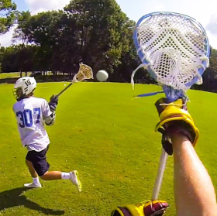
Stick Fundamentals
Pick which hand, 2 grab points

Slide 4
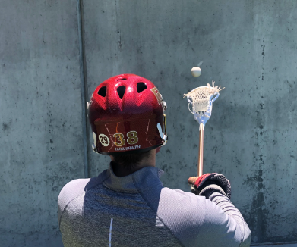
Wall
Training tool, Realtime, set speed
Use the two grab points as a hierarchy with the stick

Slide 5
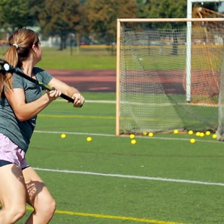
Goal
Shoot on real goal, like wall
Pivot from wall

Slide 6
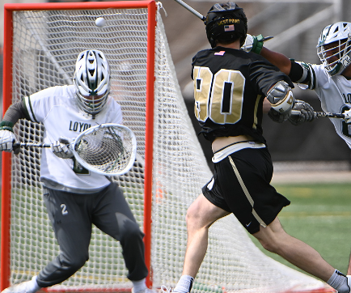
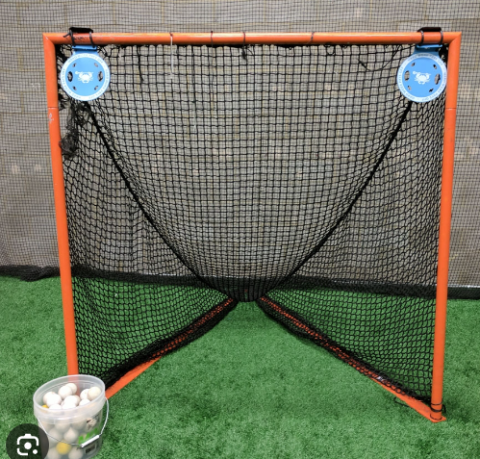
Targets, AI Generated Goalie
Shoot on real goal, like wall
Pivot from wall

